Slide 1
Ant Farm
105030009 黎佑廷 105030010 彭靖 105030015 郭家瑋

Slide 2
遊戲簡介
一個螞蟻養成遊戲
螞蟻分為三種，普通螞蟻、工蟻、兵蟻，其中工蟻可以撿食物，兵蟻可以抵禦外敵
撿食物回到蟻窩後，可以繁殖更多螞蟻

Slide 3
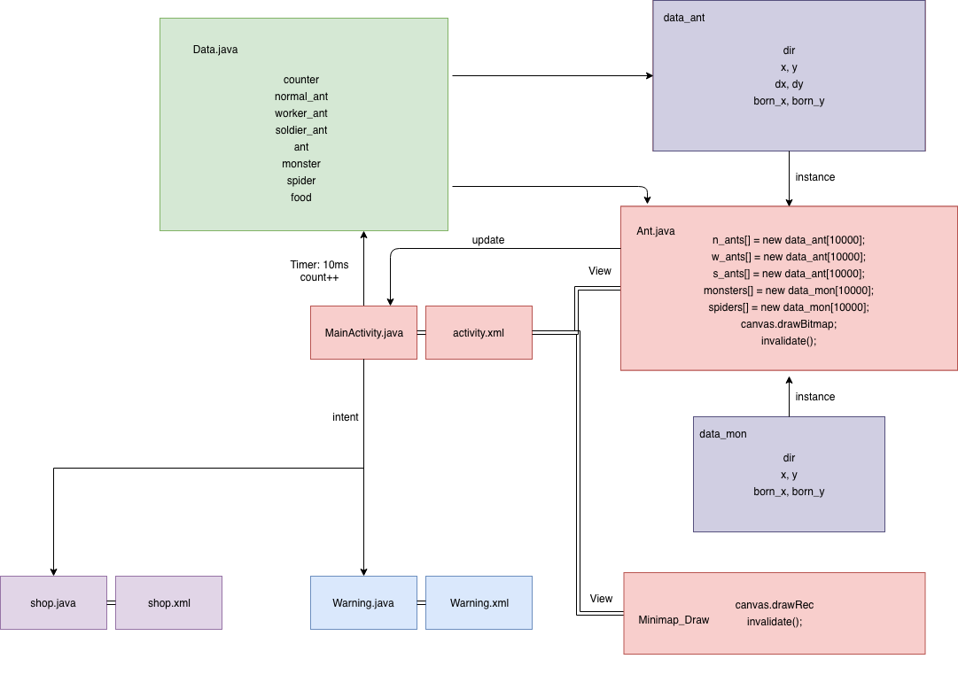
Block Diagram

Slide 4
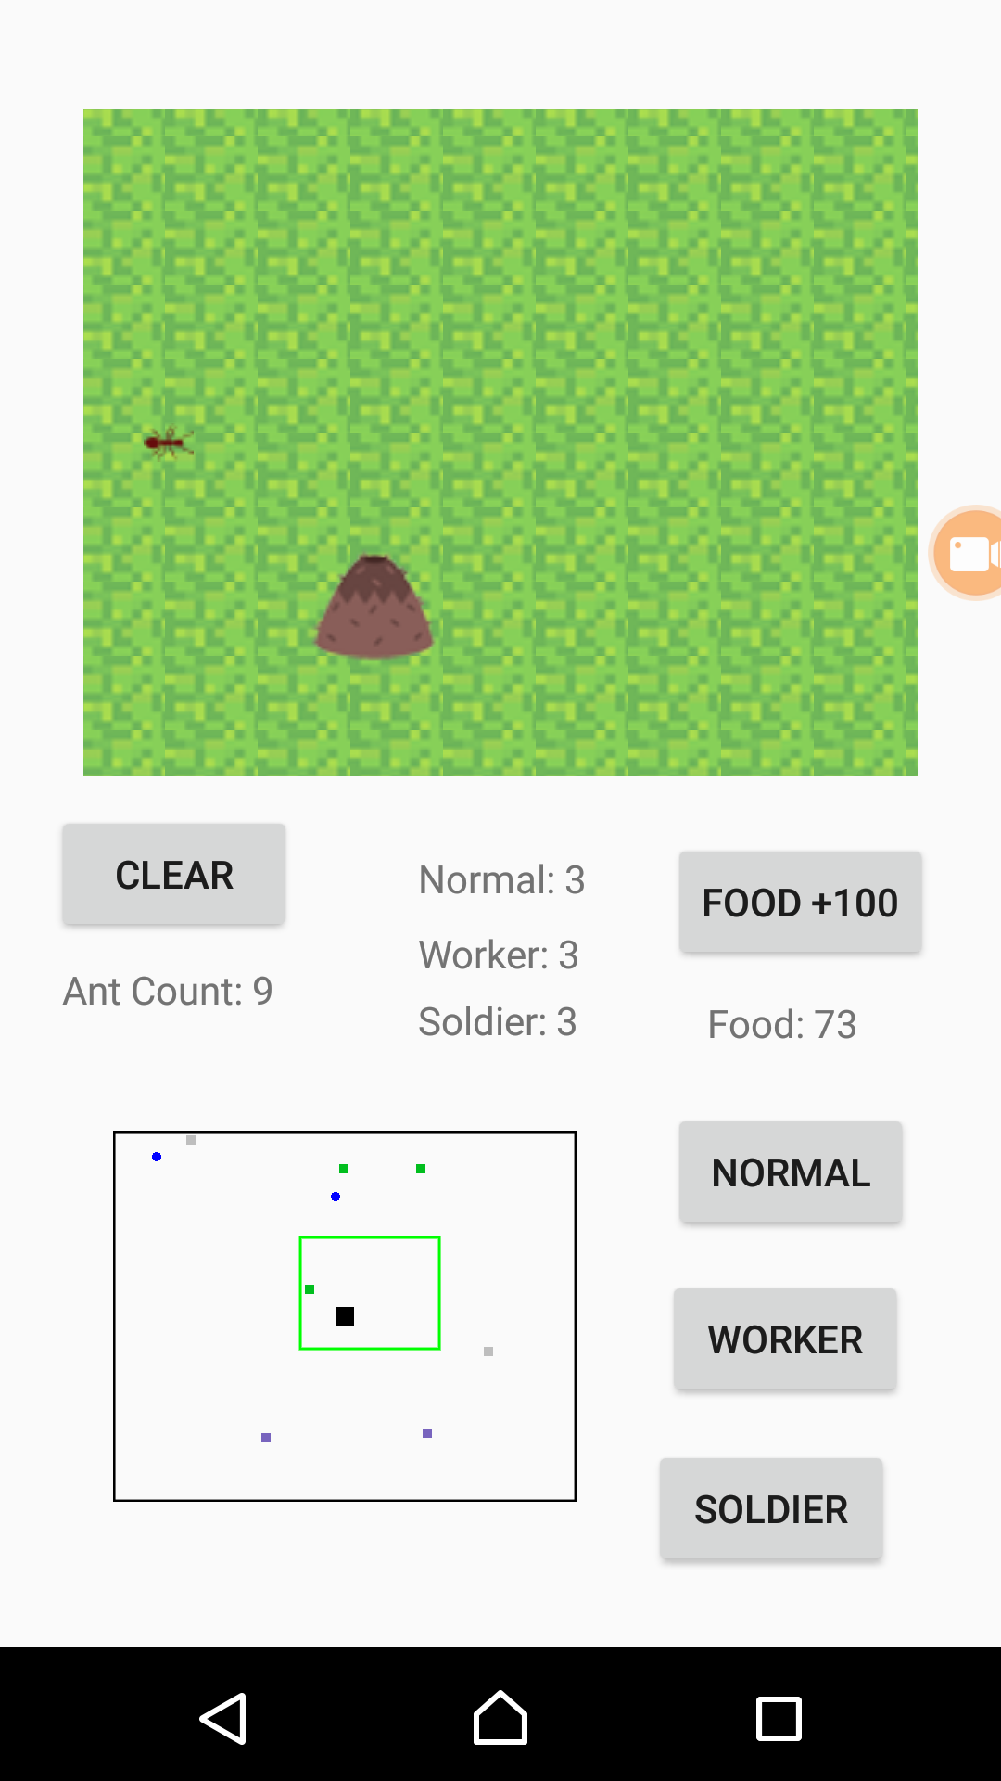
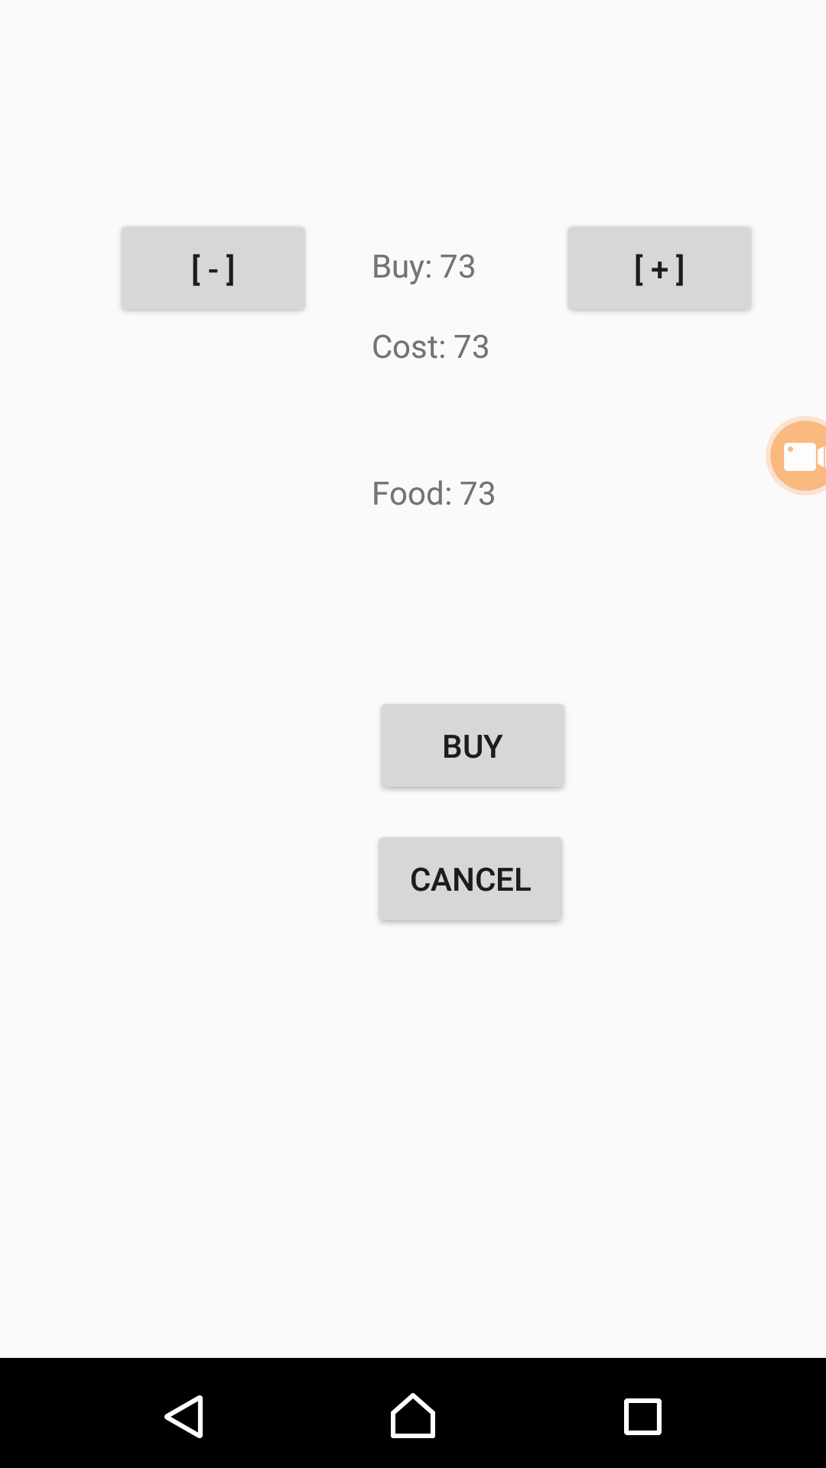
Layout

Slide 5
Main Activity
Timer：count++ and upgrade positions by dx, dy given by
Buttons to add three kinds of ants, trigger intent
TextViews to show number of three kinds of ants
View minimap
View Map
View.OnClickListener();

Slide 6
shop
Textviews to show cost, food
Buttons to buy or cancel
Cancel button to trigger intent

Slide 7
warning
Button to trigger intent

Slide 8
Ant class
Public static data_ant[] n_ants = new data_ant[10000]
Public static data_ant[] w_ants = new data_ant[10000]
Public static data_ant[] s_ants = new data_ant[10000]
Public static data_mon[] monsters = new data_mon[10000]
Public static data_mon[] spiders = new data_mon[10000]
Bitmap grass
Use count to do animate ant, spider (setBitmap, drawBitmap)
drawCircle
Fight to determine number of ants– or monsters--

Slide 9
Data_ant
born_x, born_y
x, y
goWhere();
Random_go() : change its direction every 2500ms;
March_toward_target();

Slide 10
Data_Mon
Initialize and control the parameter of spiders
monster_x, monster_y
spider_x, spider_y
init_spider_y = -650

Slide 11
Minimap_draw
OnDraw(): blue -- spider , normal_ant – gray, work_ant – green , soldier_ant -- red;
OnTouchEvent();

Slide 12
畫面截圖

Slide 13
仍待改進
Data_Ant.go_where();

